Slide 1
Education Institution Management
& Monitoring System
Name Student ID
Kamrul Hasan Shourav 1005097
Mahabub Zoraf 1005106
Aminul Haque Ripon 1005107
Md. Bulbul Sharif 1005108
Ashif Salman Rupsha 1005109

Slide 2
Subsystems
1. Monitoring teachers performance
2. Monitoring institutions performance
3. Monitoring students performance
4. Book distribution
5. Registration of PSC

Slide 3
Actors
Directorate of primary and mass education
Directorate of secondary and higher education
Textbook Board
Primary school / kinder garden
High school
Invigilator
District primary education office
District education office

Slide 4
Actors Glossary
Actor | Short Key
1. Directorate of primary and mass education | DPME
2. Directorate of secondary and higher education | DSHE
3. Textbook Board | TB
4. Primary school / kinder garden | PS/KG
5. High school | HS
6. Invigilator | I
7. District primary education office | DPEO
8. District education office | DEO

Slide 5
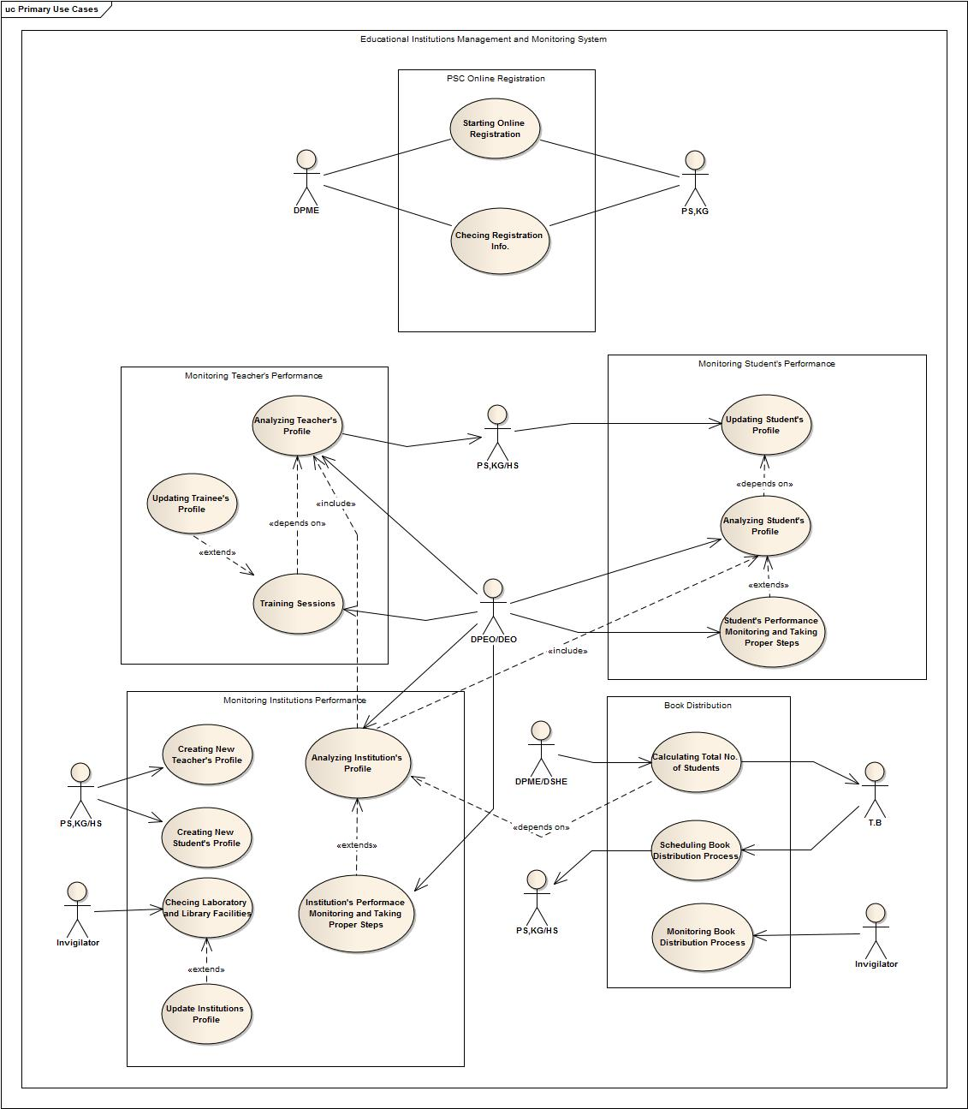

Slide 6
Monitoring teachers performance
Use case glossary:
Use Case ID : Name | Actor
1.1 : Analyzing teachers profile | PS/ HS/ KG/DPEO/ DEO
1.2 : Training session | DPEO/ DEO

Slide 7
1.1 Analyzing teachers profile
Use Case Name | Define Route and Price
Use case ID | 1.1
Priority | HIGH
Primary system actor | DPEO / DEO
Primary Business Actor | PS/ KG / HS
Trigger | “Training Session” and “Analyzing Institution’s Profile” use cases

Slide 8
Use case: Analyzing teachers profile
Typical course on event:
Actor Action | System Response
1. Click the button “Analyze Teachers Profile” | 2. A new page will open with some fields which are about the category of teachers
3. Fills the form and click “Submit” button | 4. Starts analyzing with the data of profile and the result of that teacher’s students
 | 5. Gives a rating to all the teachers who are under the given category
 | 6. Shows the list with rating

Slide 9
Alternate course of event:
Actor Action | System response
Alt-step 3: Fields are not filled perfectly. | Alt-step 4: Shows error messages and opens new page to input.
Conclusion: Concludes when all the profiles are given a rating
Post- conditions: A list of all the teachers with rating is made and shown

Slide 10
1.2 Training session
Use Case Name | Define Route and Price
Use case ID | 1.2
Priority | HIGH
Primary business actor | NONE
Primary System Actor | DPEO / DEO
Trigger | DPEO / DEO

Slide 11
Use case: Training session
Typical course on event:
Actor Action | System Response
1. Click “Select Trainee List” button
2. Click the button “Add Teacher” | 3. New page for inserting teachers name, institutions & subject is open
4. Fields are filled with proper data | 5. All data are saved and corresponding teachers profile is updated
6. Clicks the button “Complete” | 7. Saves the full list

Slide 12
Alternate course of event:
Actor Action | System response
4. Fields are not filled properly | 5. Shows error message and opens new page to input
Post condition: A list of all the teachers is made and shown.
Conclusion: When trainee list is saved and all the profiles are updated this case is ended

Slide 13
2. Monitoring institutions performance
Use case glossary:
Use Case ID : Name | Actor
2.1 : Create new teachers profile | PS/KG /HS
2.2 : Create new students profile | PS/KG/ HS
2.3 : Institution’s Performance Monitoring and Taking Proper Steps | DPEO / DEO

Slide 14
2.1 Create new teachers profile
Use Case Name | Define Route and Price
Use case ID | 2.1
Priority | HIGH
Primary System actor | PS / KG/ HS
External actor | NONE
Trigger | PS / KG / KG

Slide 15
Use case: Add new teacher
Typical course on event:
Actor Action | System Response
1. None | 2. Ask for user ID & password through an interface
3. Gives user ID & password as input in login page | 4. Used ID & password is verified & page for choosing option is open
5. Selects add teacher option from the option list and clicks “OK” button | 6. New page for insertion teachers information is open
7. Proper information will be given in the respective fields

Slide 16
Alternate course of event:
Actor Action | System response
3. May give wrong user ID & password | 4. Provide new log in page
Post conditions: None
Conclusion: This use case concludes when teachers record is added and a new page with filled form with the information is shown

Slide 17
2.2 Create new students profile
Use Case Name | Define Route and Price
Use case ID | 2.2
Priority | HIGH
Primary System actor | PS / KG / HS
External actor | NONE
Trigger | PS/ KG/ HS

Slide 18
Use case: Add new Students
Typical course on event:
Actor Action | System Response
1. None | 2. Ask for user ID & password through an interface
3. Gives user ID & password as input in login page | 4. Used ID & password is verified & page for choosing option is open
5. Selects add students option from the option list and clicks “OK” button | 6. New page for insertion students information is open
7. Proper information will be given in the respective fields

Slide 19
Alternate course of event:
Actor Action | System response
3. May give wrong user ID & password | 4. Provide new log in page
Post conditions: None
Conclusion: This use case concludes when students record is added and a new page with filled form with the information is shown

Slide 20
2.3 Institution’s Performance Monitoring and Taking Proper Steps
Use Case Name | Define Route and Price
Use case ID | 2.3
Priority | HIGH
Primary business actor | DPEO / DEO
External actor | NONE
Trigger | DPEO / DEO

Slide 21
Use case: Institution’s Performance Monitoring and Taking Proper Steps
Typical course on event:
Actor Action | System Response
1. Click the button “Analyze Institutions Profile” | 2. A new page will open with some fields which are about the category of institutions
3. Fills the form and click “Submit” button | 4. Starts analyzing with the data of profile and the result of that institution’s students
 | 5. Gives a rating to all the institutions which are under the given category
 | 6. Shows the list with rating
 | 7: Proper steps are taken according to the rating

Slide 22
Alternate course of event:
Actor Action | System response
Alt-step 3: Fields are not filled perfectly | Alt-step 4: Shows error messages and opens new page to input
Conclusion: Concludes when all the profiles are given a rating
Post- conditions: A list of all the institutions with rating is made and shown

Slide 23
3. Monitoring students performance
Use case glossary:
Use Case ID : Name | Actor
3.1 : Updating students profile | PS/KG/HS
3.2 : Student’s Performance Monitoring and Taking Proper Steps | DPEO/ DEO

Slide 24
3.1 Updating students profile
Use Case Name | Define Route and Price
Use case ID | 3.1
Priority | HIGH
Primary System actor | PS / KG / HS
External actor | NONE
Trigger | PS / KG / HS

Slide 25
Use case: Updating students profile
Typical course on event:
Actor Action | System Response
1. Gives the data about semester examination result and attendance | 2. Updates profile of each students with the given data
Conclusion: concludes when the profile of all students of an institutions are updated
Post-condition: Performs some related calculation

Slide 26
3.2 Student’s Performance Monitoring and Taking Proper Steps
Use Case Name | Define Route and Price
Use case ID | 3.2
Priority | HIGH
Primary System actor | DPEO / DEO
External actor | NONE
Trigger | DPEO / DEO

Slide 27
Use case: Student’s Performance Monitoring and Taking Proper Steps
Typical course on event:
Actor Action | System Response
1. Click the button “Analyze Students Profile” | 2. A new page will open with some fields which are about the category of students
3. Fills the form and click “Submit” button | 4. Starts analyzing with the data of profile and the result of that student
 | 5. Gives a rating to all the students who are under the given category
 | 6. Shows the list with rating
 | 7: Taking Further steps according to the rating.

Slide 28
Alternate course of event:
Actor Action | System response
Alt-step 3: Fields are not filled perfectly. | Alt-step 4: Shows error messages and opens new page to input
Conclusion: Concludes when all the profiles are given a rating
Post- conditions: A list of all the students with rating is made and shown

Slide 29
4. Book distribution
Use case glossary:
Use Case ID : Name | Actor
4.1 : Calculating total number of students | DPME/ DSHE, TB
4.2 : Scheduling book distribution process | TB, PS/KG / HS
4.3 : Monitoring book distribution process | I, PS/KG /HS

Slide 30
4.1 Calculating total number of students
Use Case Name | Define Route and Price
Use case ID | 4.1
Priority | HIGH
Primary business actor | TB
Primary System Actor | DPME / DHSE
Trigger | DPME / DHSE

Slide 31
Use case: Calculating total number of students
Typical course on event:
Actor Action | System Response
1. DPME gives command to calculate total number of students | 2. Calculates the total number of students of all institutions
 | 3. Sends the data to TB
4. TB receives the data and print required number of books

Slide 32
Conclusion: Concludes when the data is send to TB
Post- conditions: None

Slide 33
4.2 Scheduling book distribution process
Use Case Name | Define Route and Price
Use case ID | 4.2
Priority | HIGH
Primary business actor | PS / KG / HS
Primary System Actor | TB
Trigger | TB

Slide 34
Use case: Scheduling book distribution process
Typical course on event:
Actor Action | System Response
1. TB prepares the schedule for distribution of books
2. Schedule is given to the system | 3. Informs about the schedule date to corresponding institutions

Slide 35
Conclusion: Sending scheduling to all the institutions to collect their share.
Post- conditions: None

Slide 36
4.3 Monitoring book distribution process
Use Case Name | Define Route and Price
Use case ID | 4.3
Priority | HIGH
Primary System actor | I
External actor | NONE
Trigger | I

Slide 37
Use case: Monitoring book distribution process
Typical course on event:
Actor Action | System Response
1. Invigilates the distribution process in school level
2. Collects and uploads data how many students have received books in hand | 3. Updates the profile of the school with the data

Slide 38
Conclusion: Concludes with taking proper steps against the institutions who black marketed the books.
Post- condition: None

Slide 39
5. PSC online registration
Use case glossary:
Use Case ID : Name | Actor
5.1 : Starting online registration | DPME, PS/KG
5.2 : Checking registration info | DPME, PS/KG

Slide 40
5.1 Starting online registration
Use Case Name | Define Route and Price
Use case ID | 5.1
Priority | HIGH
Primary business actor | DPME, PS / KG
External actor | NONE
Trigger | DPME

Slide 41
Use case: Starting online registration
Typical course on event:
Actor Action | System Response
1. DPME starts the registration process | 2. Shows the registration option to KG/PS
3. KG/PS gives all the necessary data of all the students of class five | 4. Saves all the data

Slide 42
Conclusion: Concludes with receiving students’ information from the institutions.
Post- conditions: “Checking Registration Info.” Use case may initiates if necessary.

Slide 43
5.2 Checking registration info
Use Case Name | Define Route and Price
Use case ID | 5.2
Priority | HIGH
Primary business actor | DPME, PS / KG
External actor | NONE
Trigger | DPME

Slide 44
Use case: Checking registration info
Typical course on event:
Actor Action | System Response
1. DPME starts error checking event | 2. Shows error checking option to PS/KG
3. PS/KG checks the list of all students
4. If error is found clicks the “Edit” button | 5. An editable form is open with all the previous data
6. Completes the necessary editing and clicks the button “Done” | 7. Saves the data

Slide 45
Conclusion: Concludes with updating students’ information if necessary.
Post- condition: None

Slide 46

THANK YOU

